Slide 1
AASD4012 - Big Data Tools and Techniques
Exploring Toronto’s Traffic Accidents
and its Relationship with the Weather
Group 10
Thien An Trinh
Roman Burekhin
Narjes Amousoltani Foroushani
Nishtha Khanna
Shoaib Ahmed Khan
Tina Khazaee
Prithu Bhardwaj

Slide 2
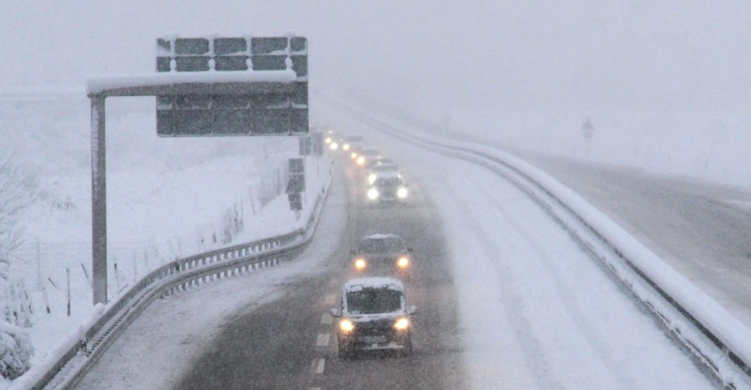
Problem Statements
Toronto is a city with a huge volume of traffic. There are collisions leading to
major or even fatal injury - https://globalnews.ca/tag/toronto-collision/
Is there any relationship between Toronto’s traffic accidents and the weather?
Is there any other relationship/pattern we can explore?
https://stlawyers.ca/blog-news/car-accidents-bad-weather-ontario/

Slide 3
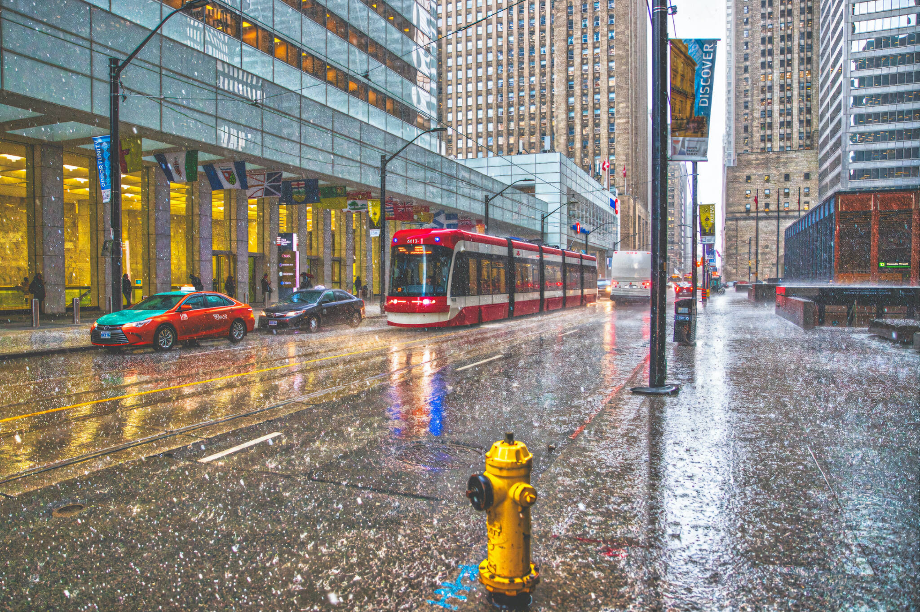
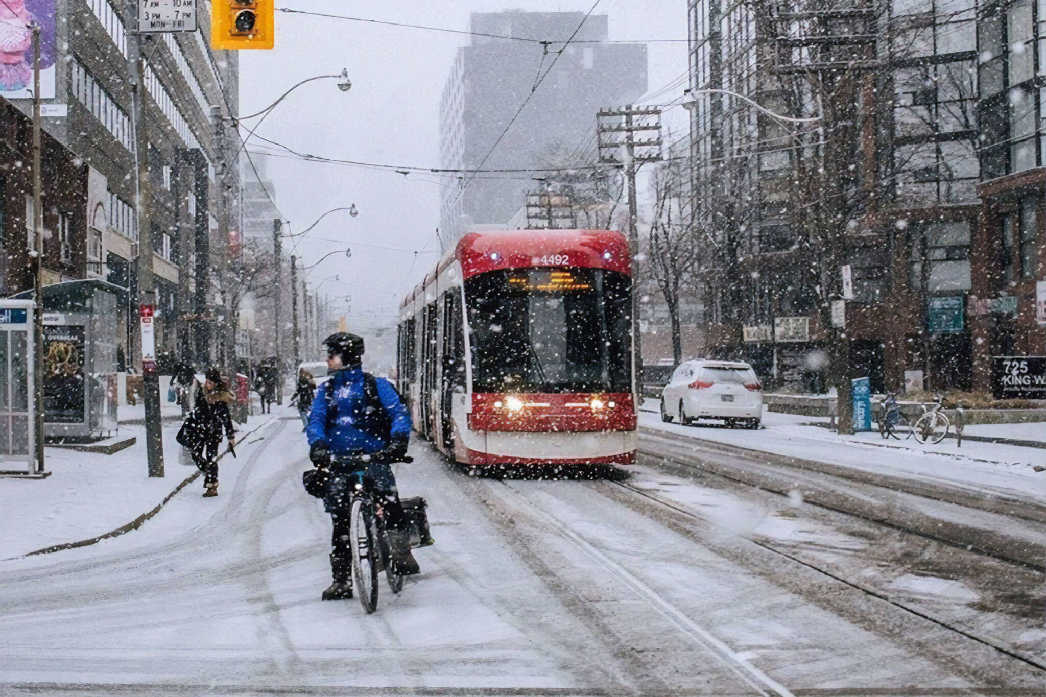
Data Sources
Structured Data
Toronto’s weather
https://toronto.weatherstats.ca/download.html
https://www.blogto.com/city/2021/09/environment-canada-warns-toronto-rain/
Semi-structured Data
KSI (Killed or Seriously Injured) data
Toronto Police Service, Public Safety Data Portal
https://data.torontopolice.on.ca/datasets/TorontoPS::ksi/explore?location=43.722211%2C-79.380682%2C10.00&showTable=true
https://www.blogto.com/city/2020/02/environment-canada-special-weather-statement-toronto-feb-24/

Slide 4
Data Pipeline
Structured Data
(csv)
DBFS
MongoDB
Semi-structured Data
(json)
PySpark
PySpark
Transactional Database
PySpark
Data Warehouse
SSIS
Visualization

Slide 5
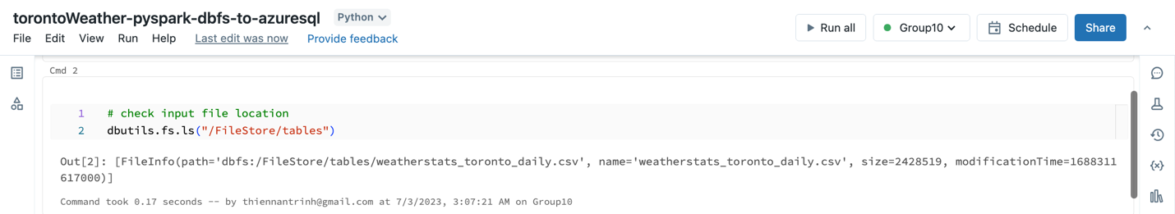
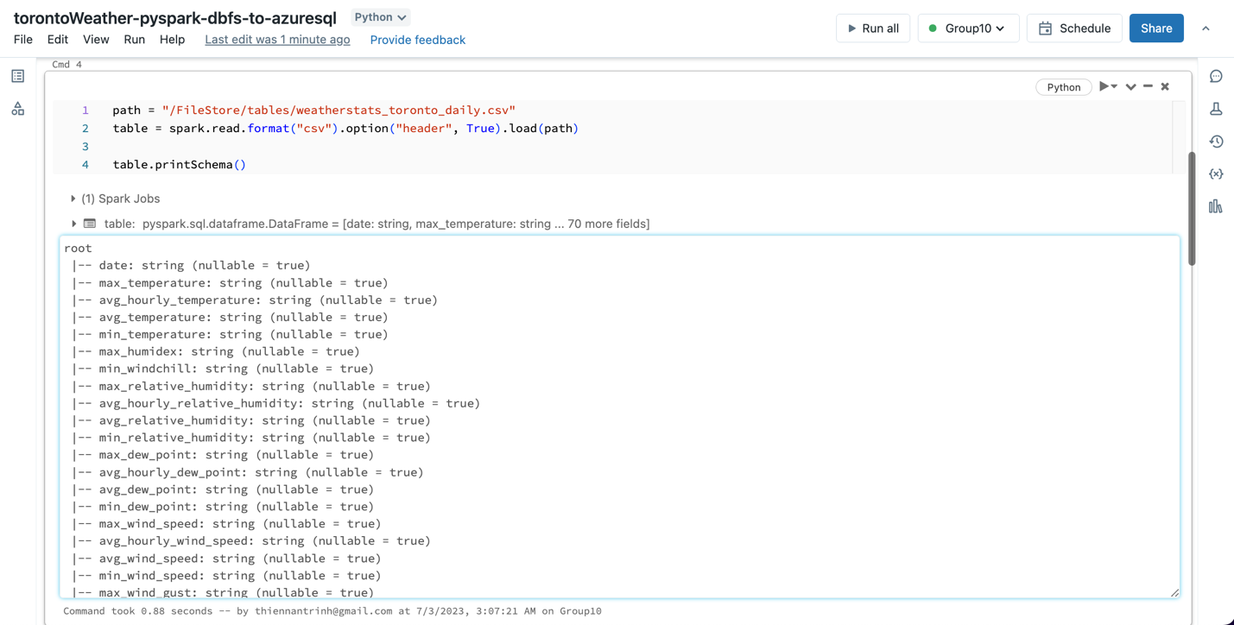
Structured Data
DBFS
PySpark
Transactional Database

Slide 6
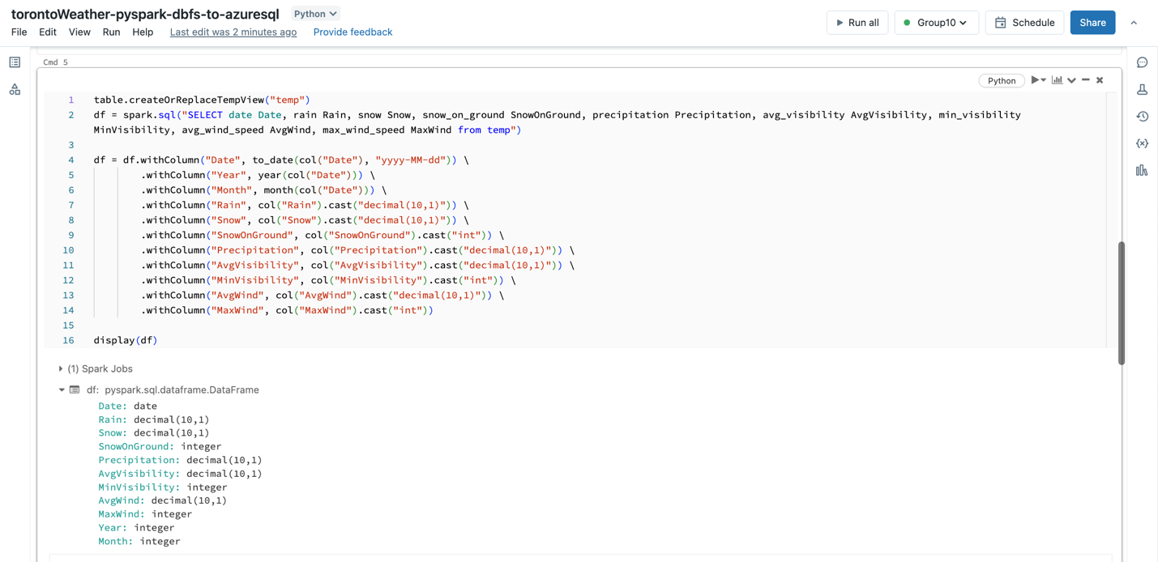
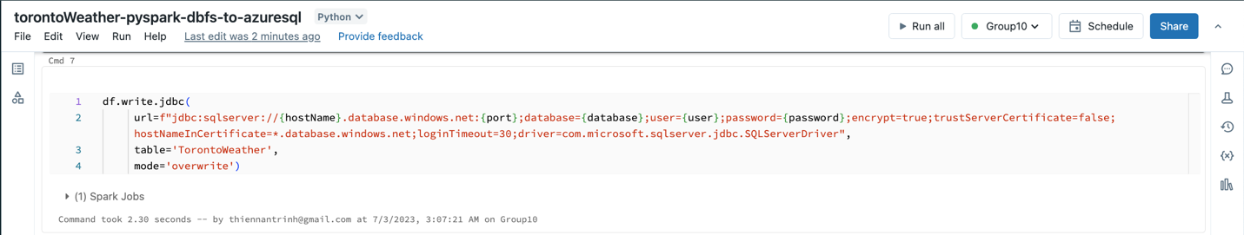
Structured Data
DBFS
PySpark
Transactional Database

Slide 7
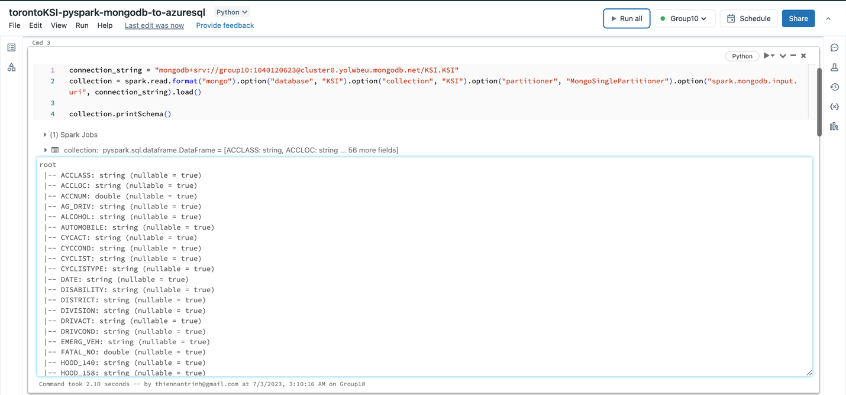
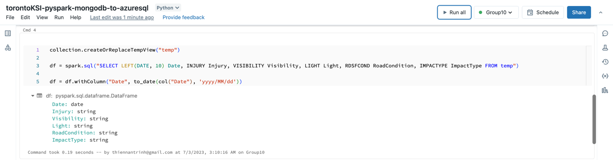
Semi-structured Data
MongoDB
PySpark
Transactional Database

Slide 8
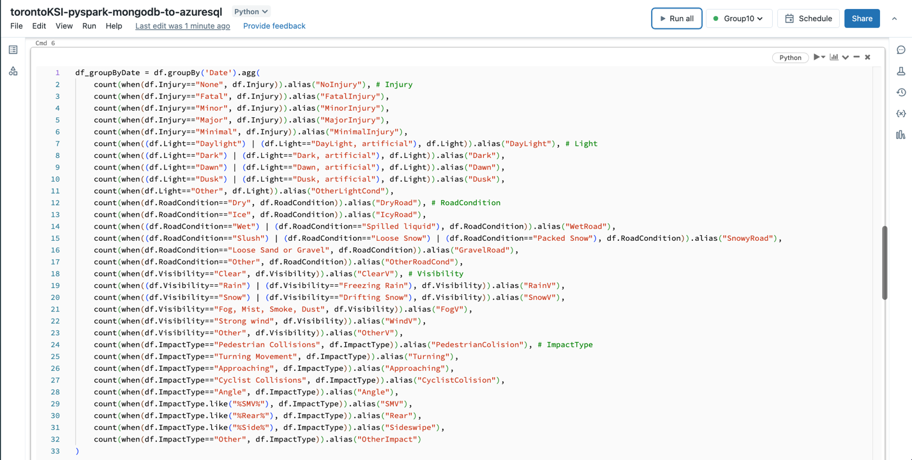
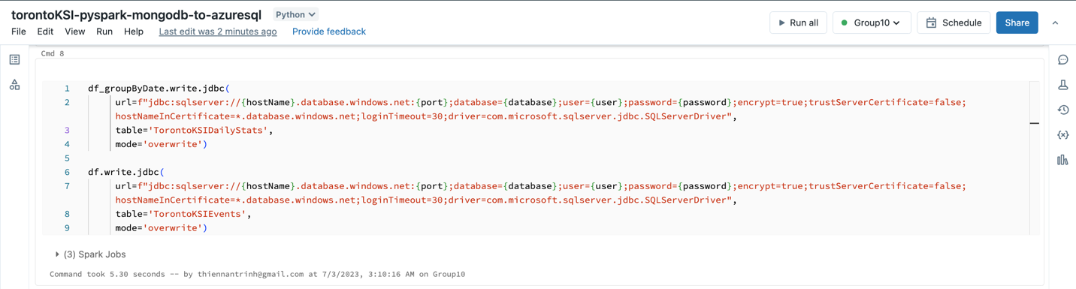
Semi-structured Data
MongoDB
PySpark
Transactional Database

Slide 9
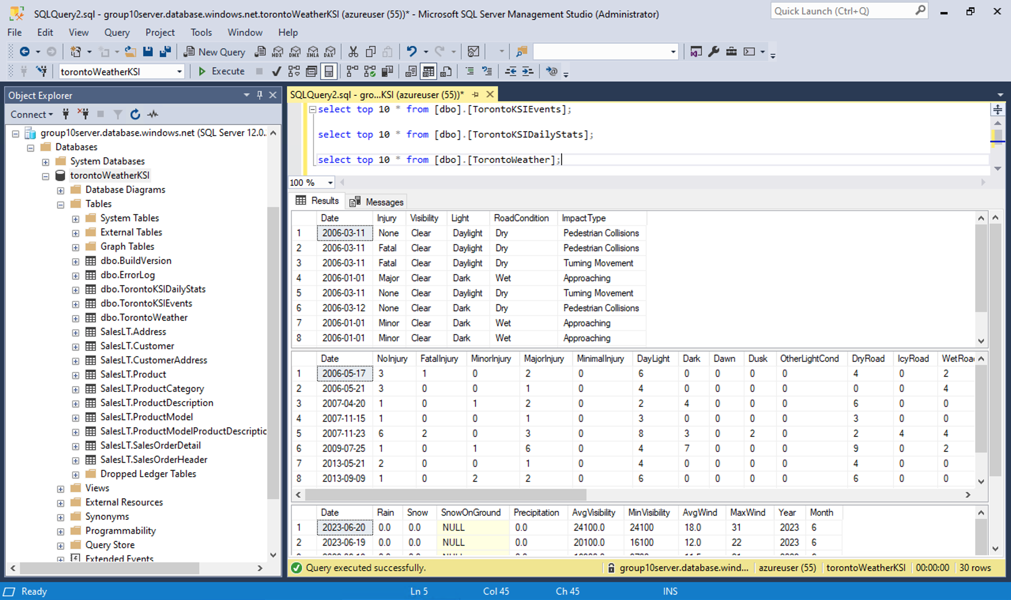
Transactional Database

Slide 10
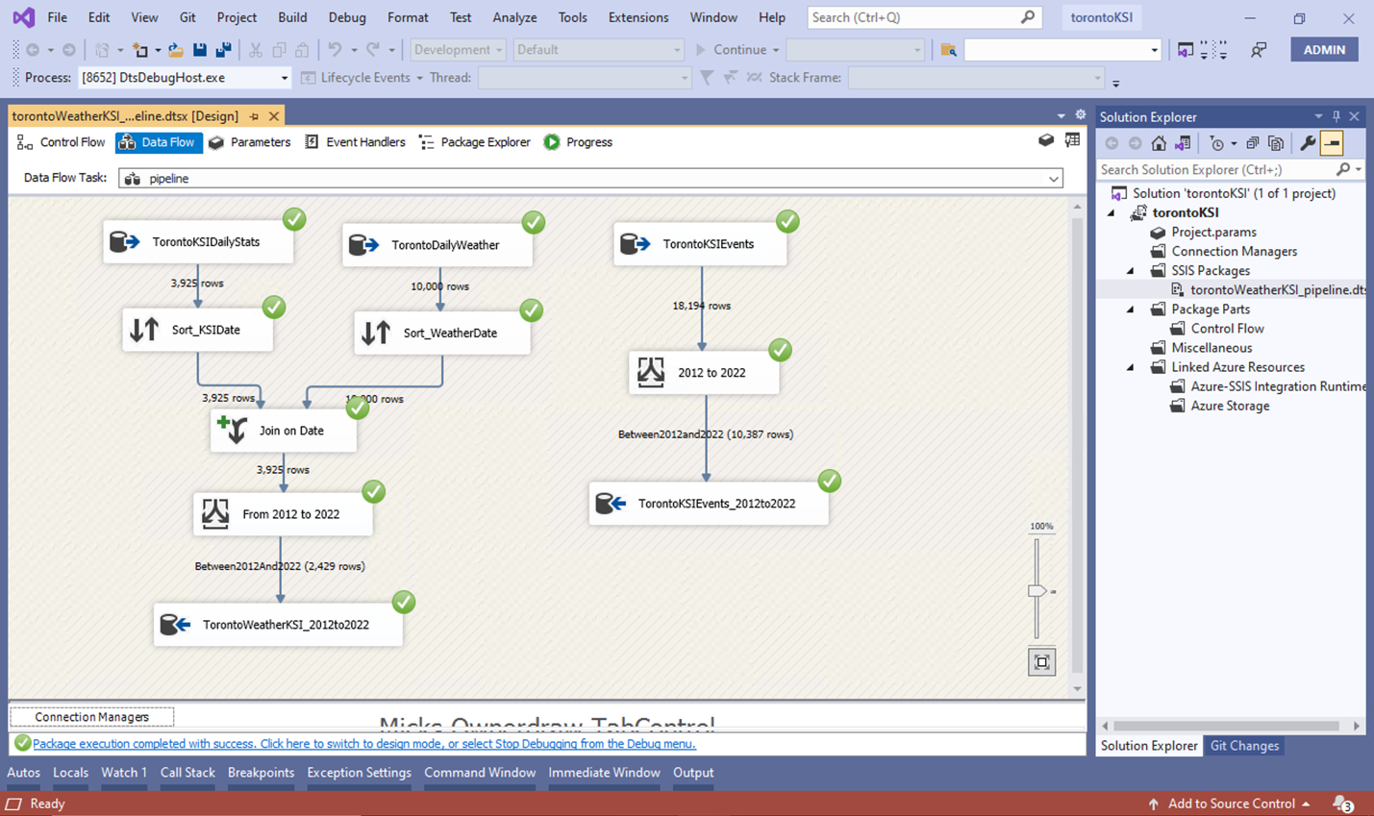
Transactional Database
SSIS
Data Warehouse

Slide 11
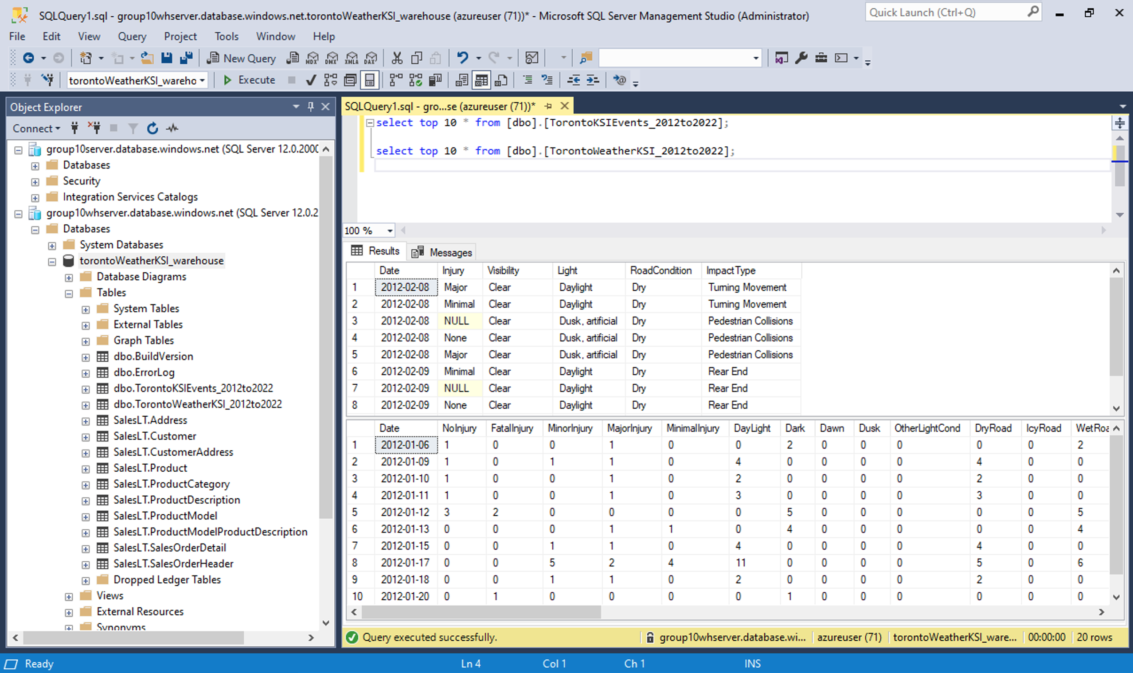
Data Warehouse

Slide 12
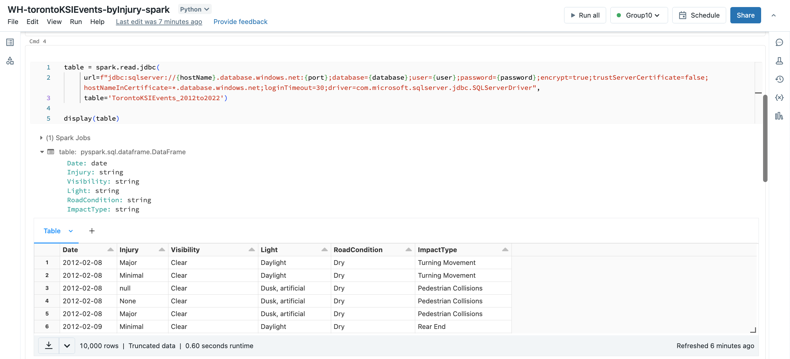
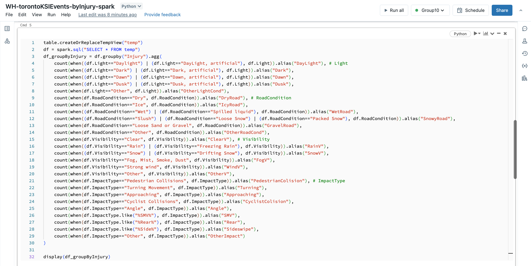
PySpark
Data Warehouse

Slide 13
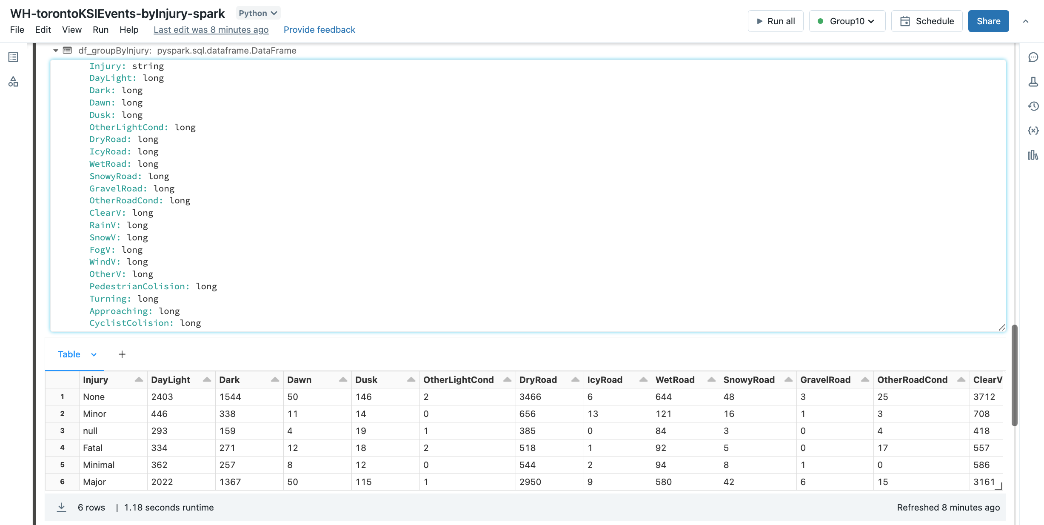
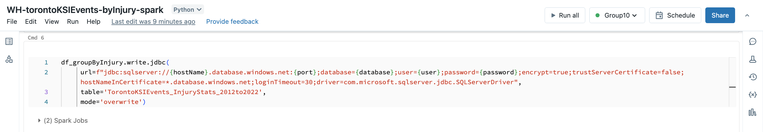
PySpark
Data Warehouse

Slide 14
Visualization
Light condition
Impact Type
Time
Special Involvement
Road Condition
Injury
Visibility
Enriching
Rain
Snow
Injury
Precipitation
Vehicle
Snow on Ground
Wind
Impact Type
Visibility

Slide 15
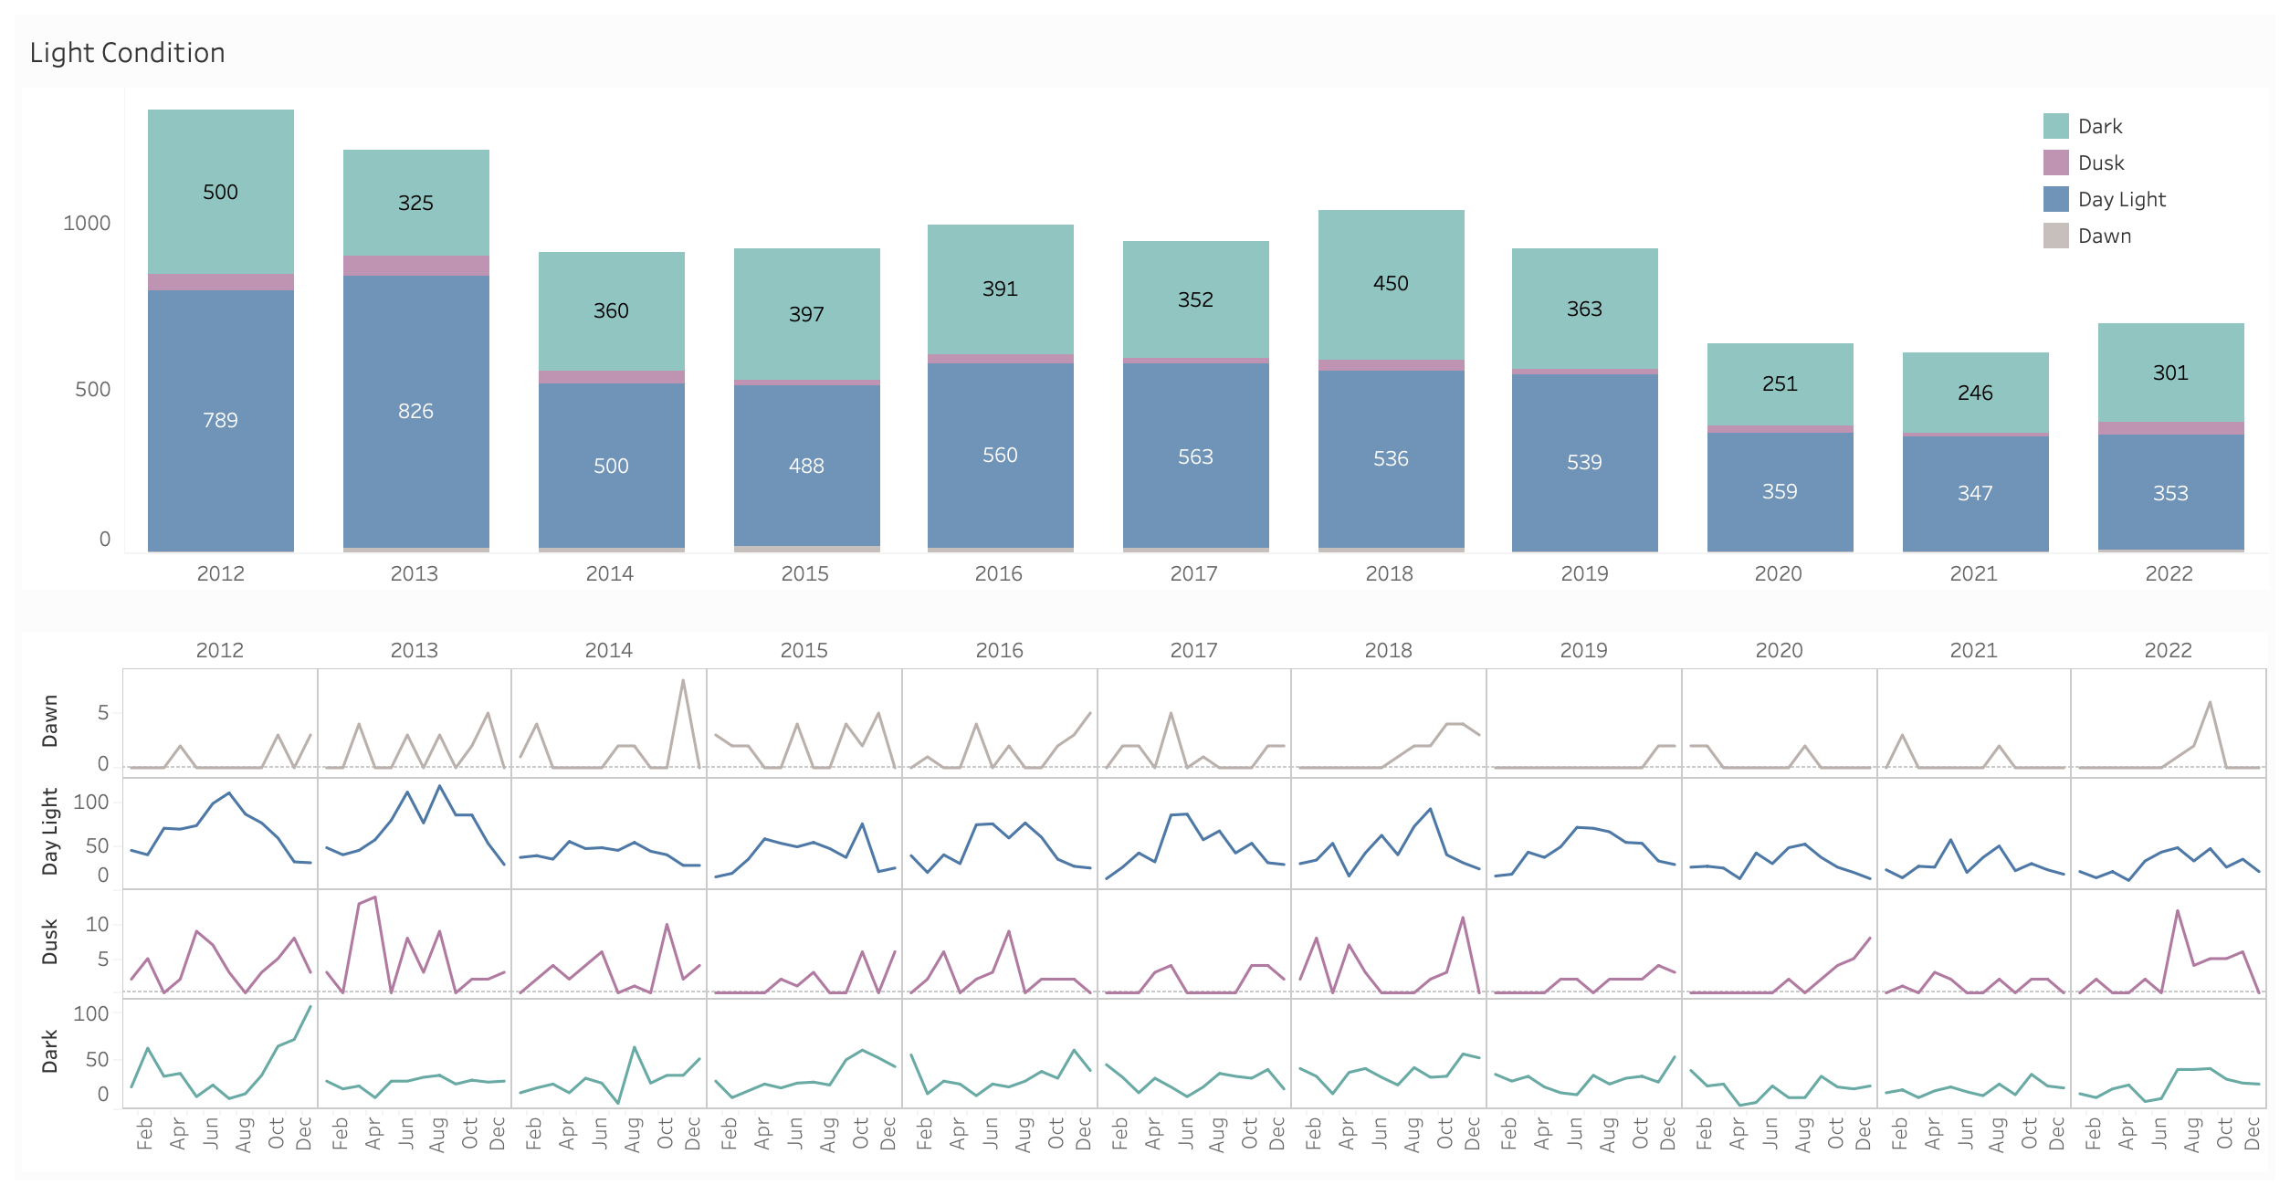
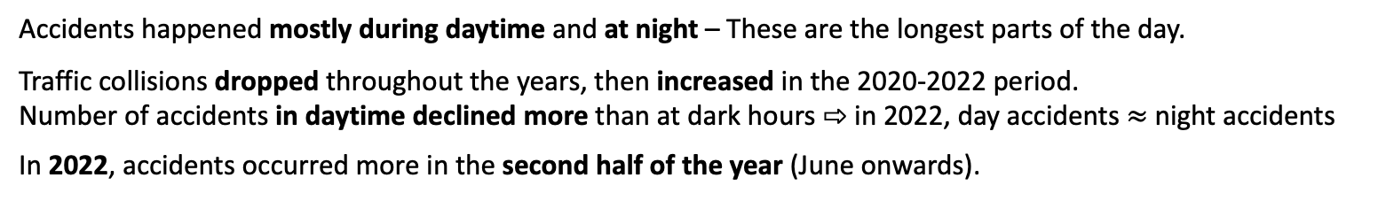
Visualization
Accidents happened mostly during daytime and at night – These are the longest parts of the day.
Traffic collisions dropped throughout the years, then increased in the 2020-2022 period.
Number of accidents in daytime declined more than at dark hours ⇨ in 2022, day accidents $≈$ night accidents
In 2022, accidents occurred more in the second half of the year (June onwards).

Slide 16
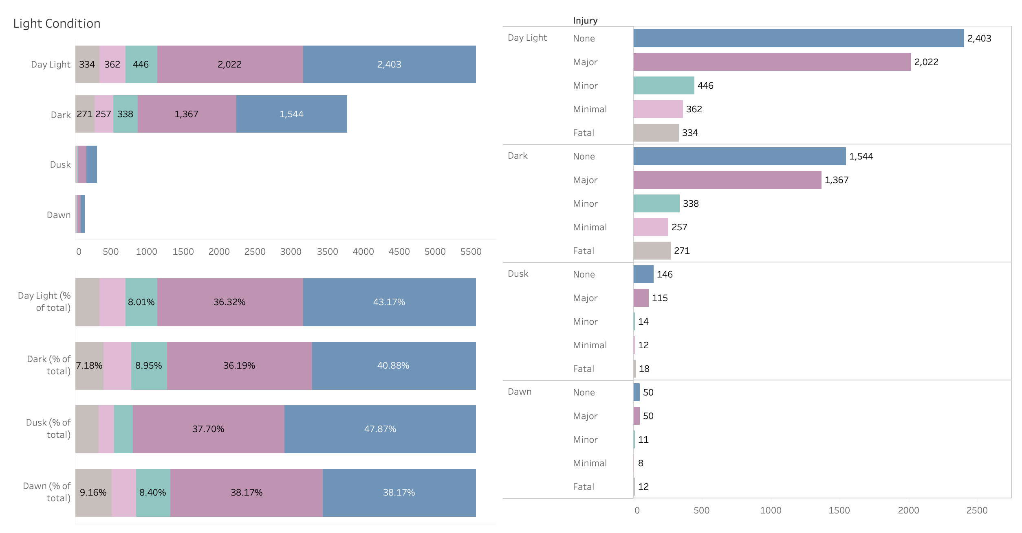

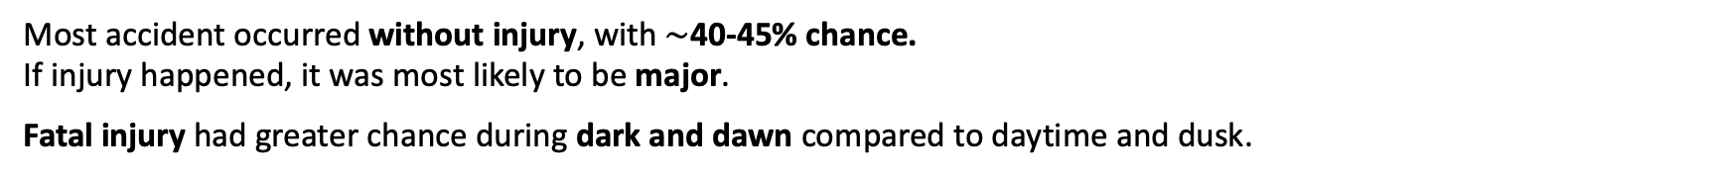
Visualization
Most accident occurred without injury, with $\sim$40-45% chance.
If injury happened, it was most likely to be major.
Fatal injury had greater chance during dark and dawn compared to daytime and dusk.

Slide 17
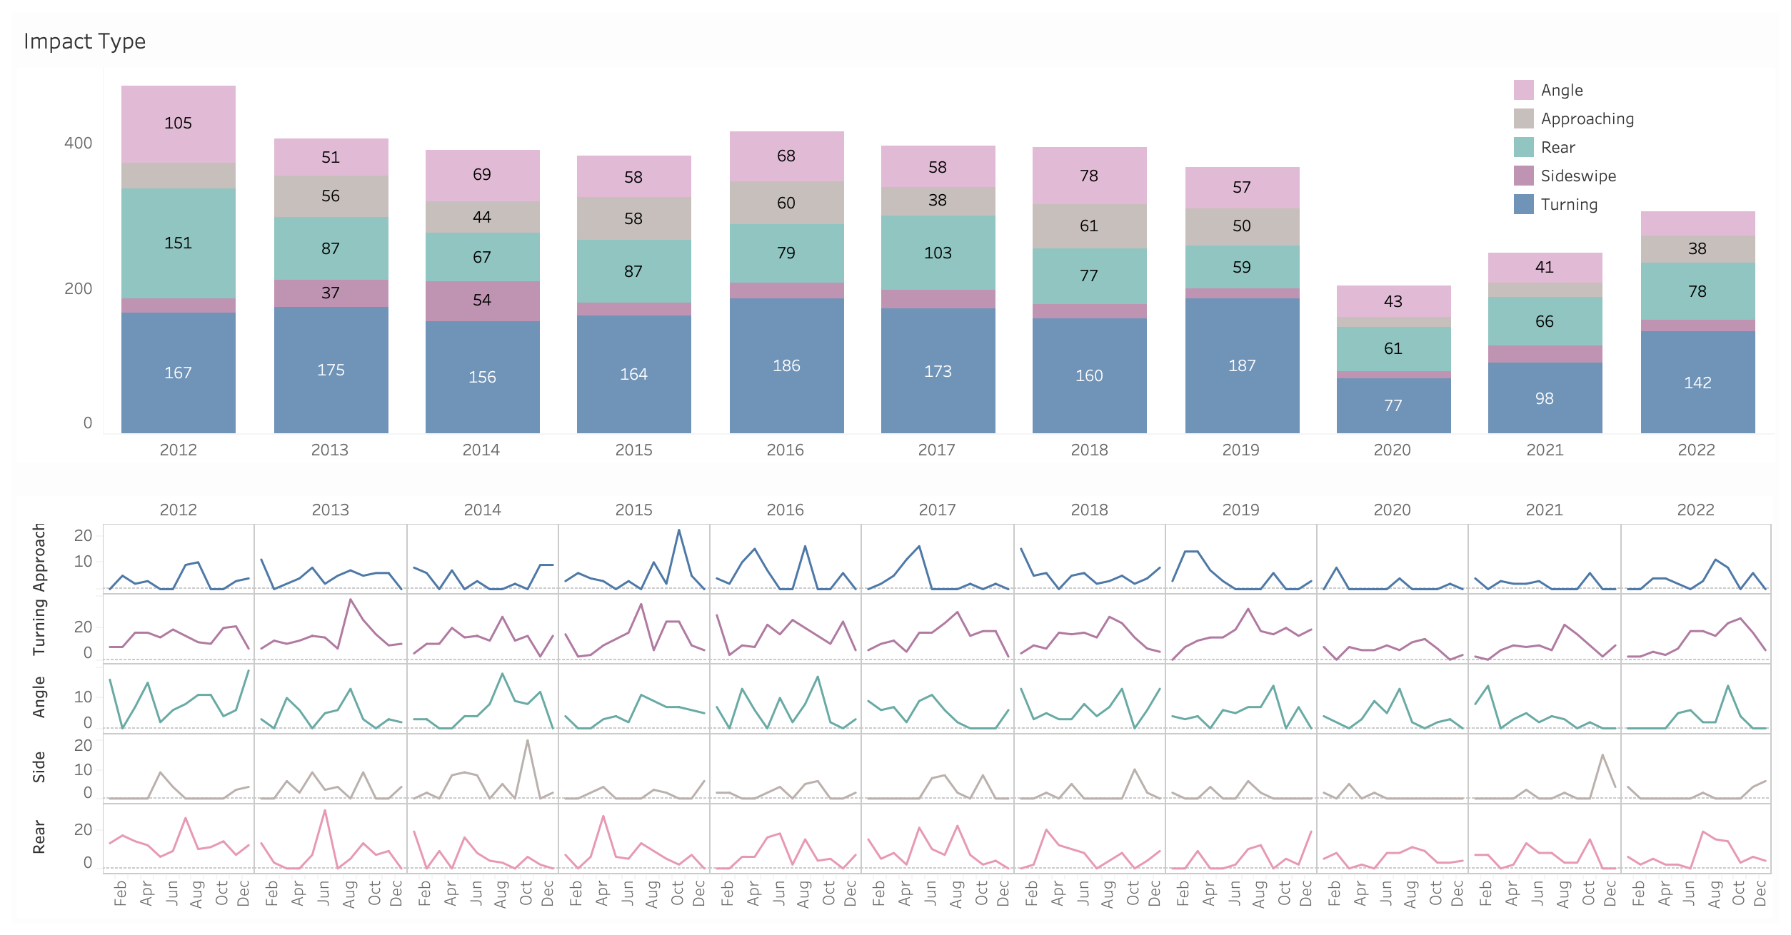
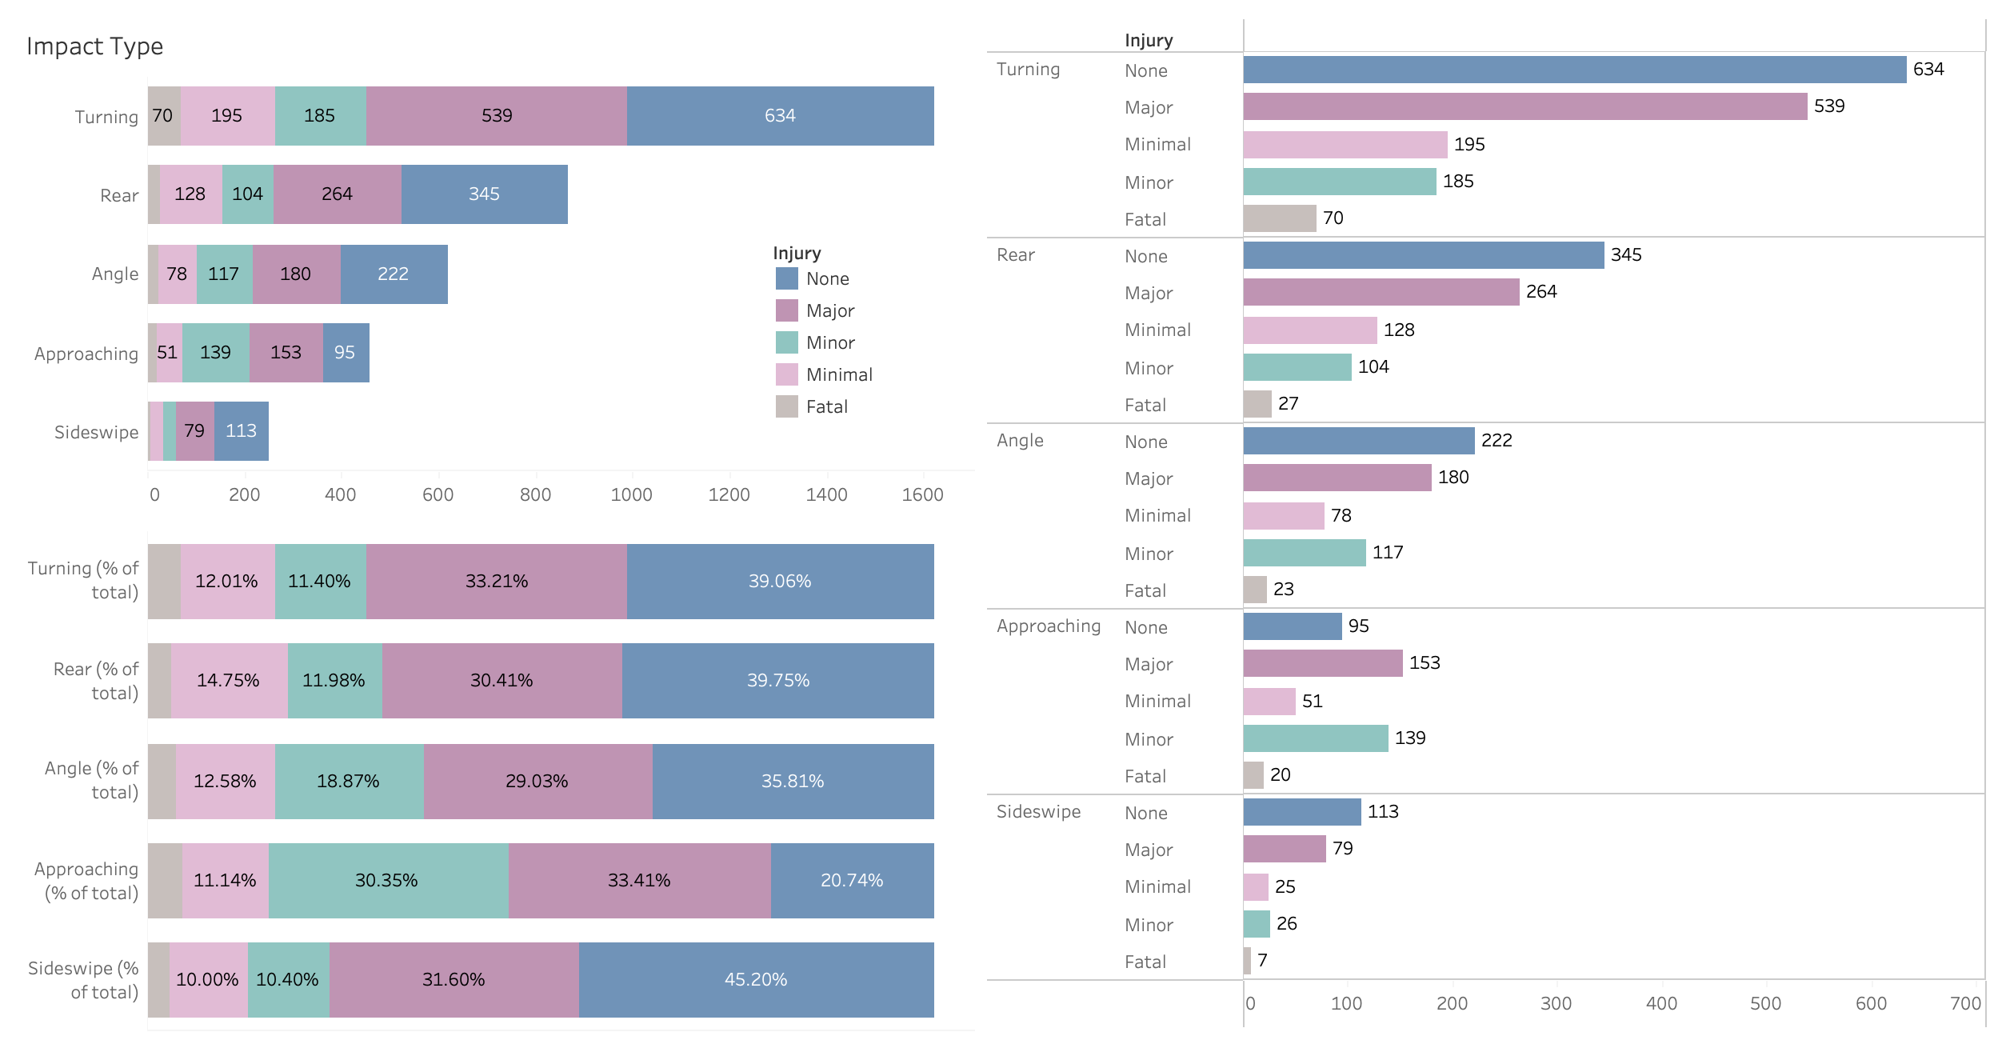
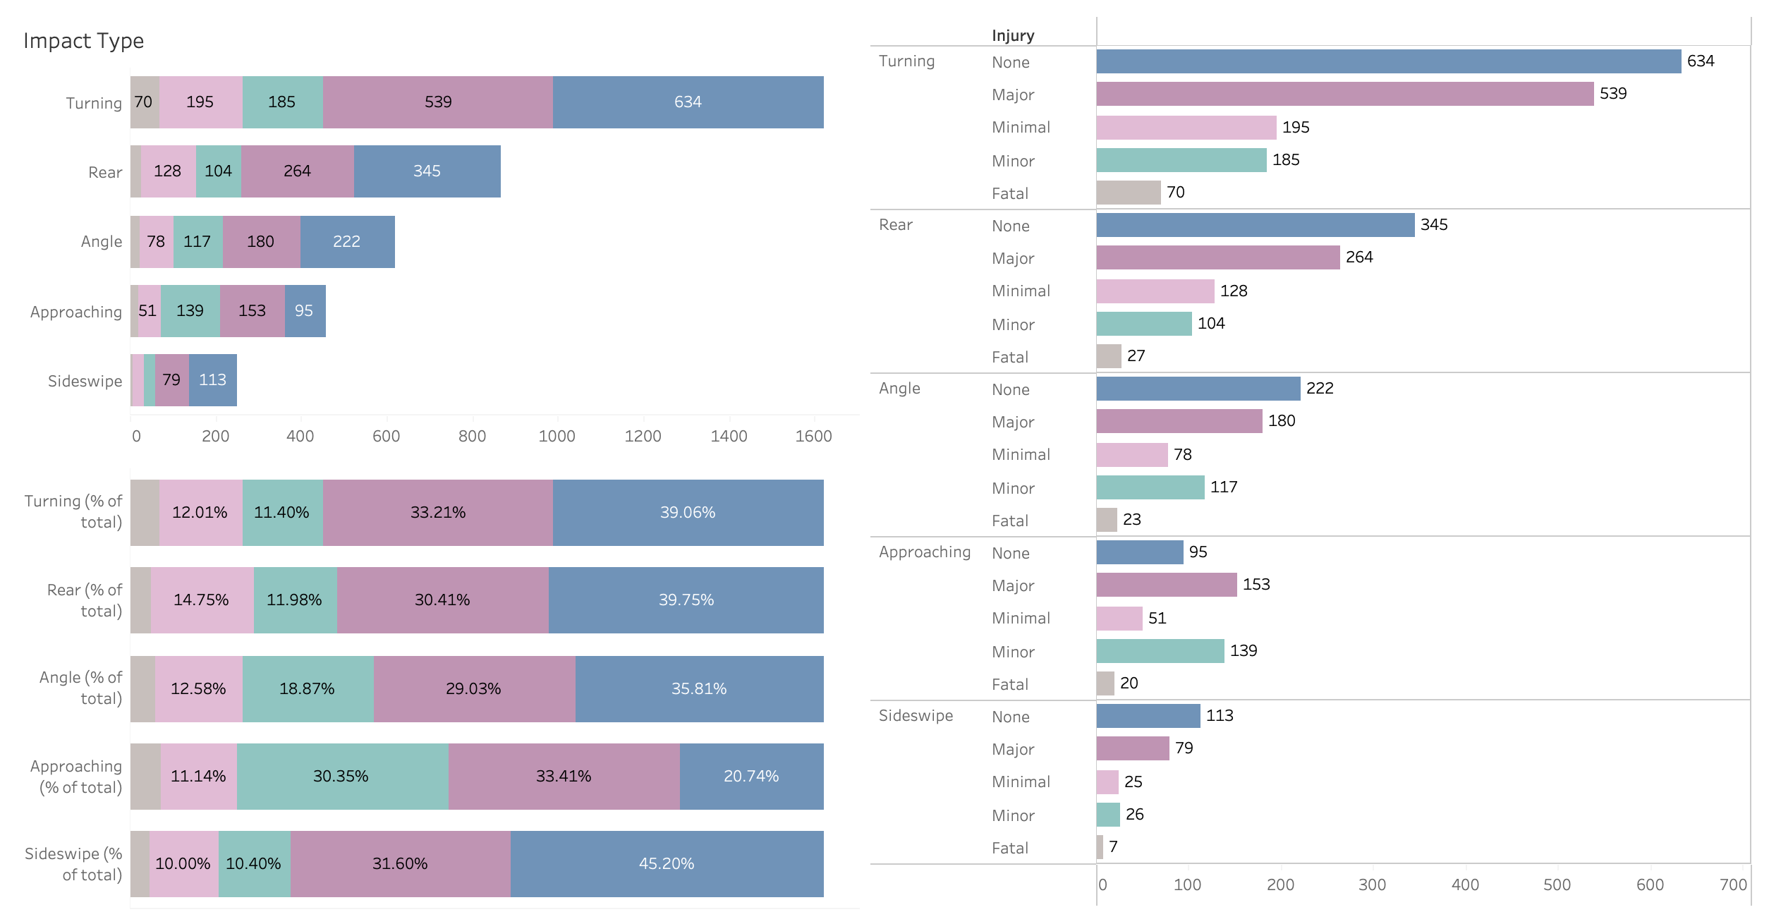
Visualization
Turning collisions happened most frequently, followed by rear collisions.
Turning collisions occurred almost as twice as rear collisions.
In a collision with approaching impact, major and minor injury had greater chance.

Slide 18
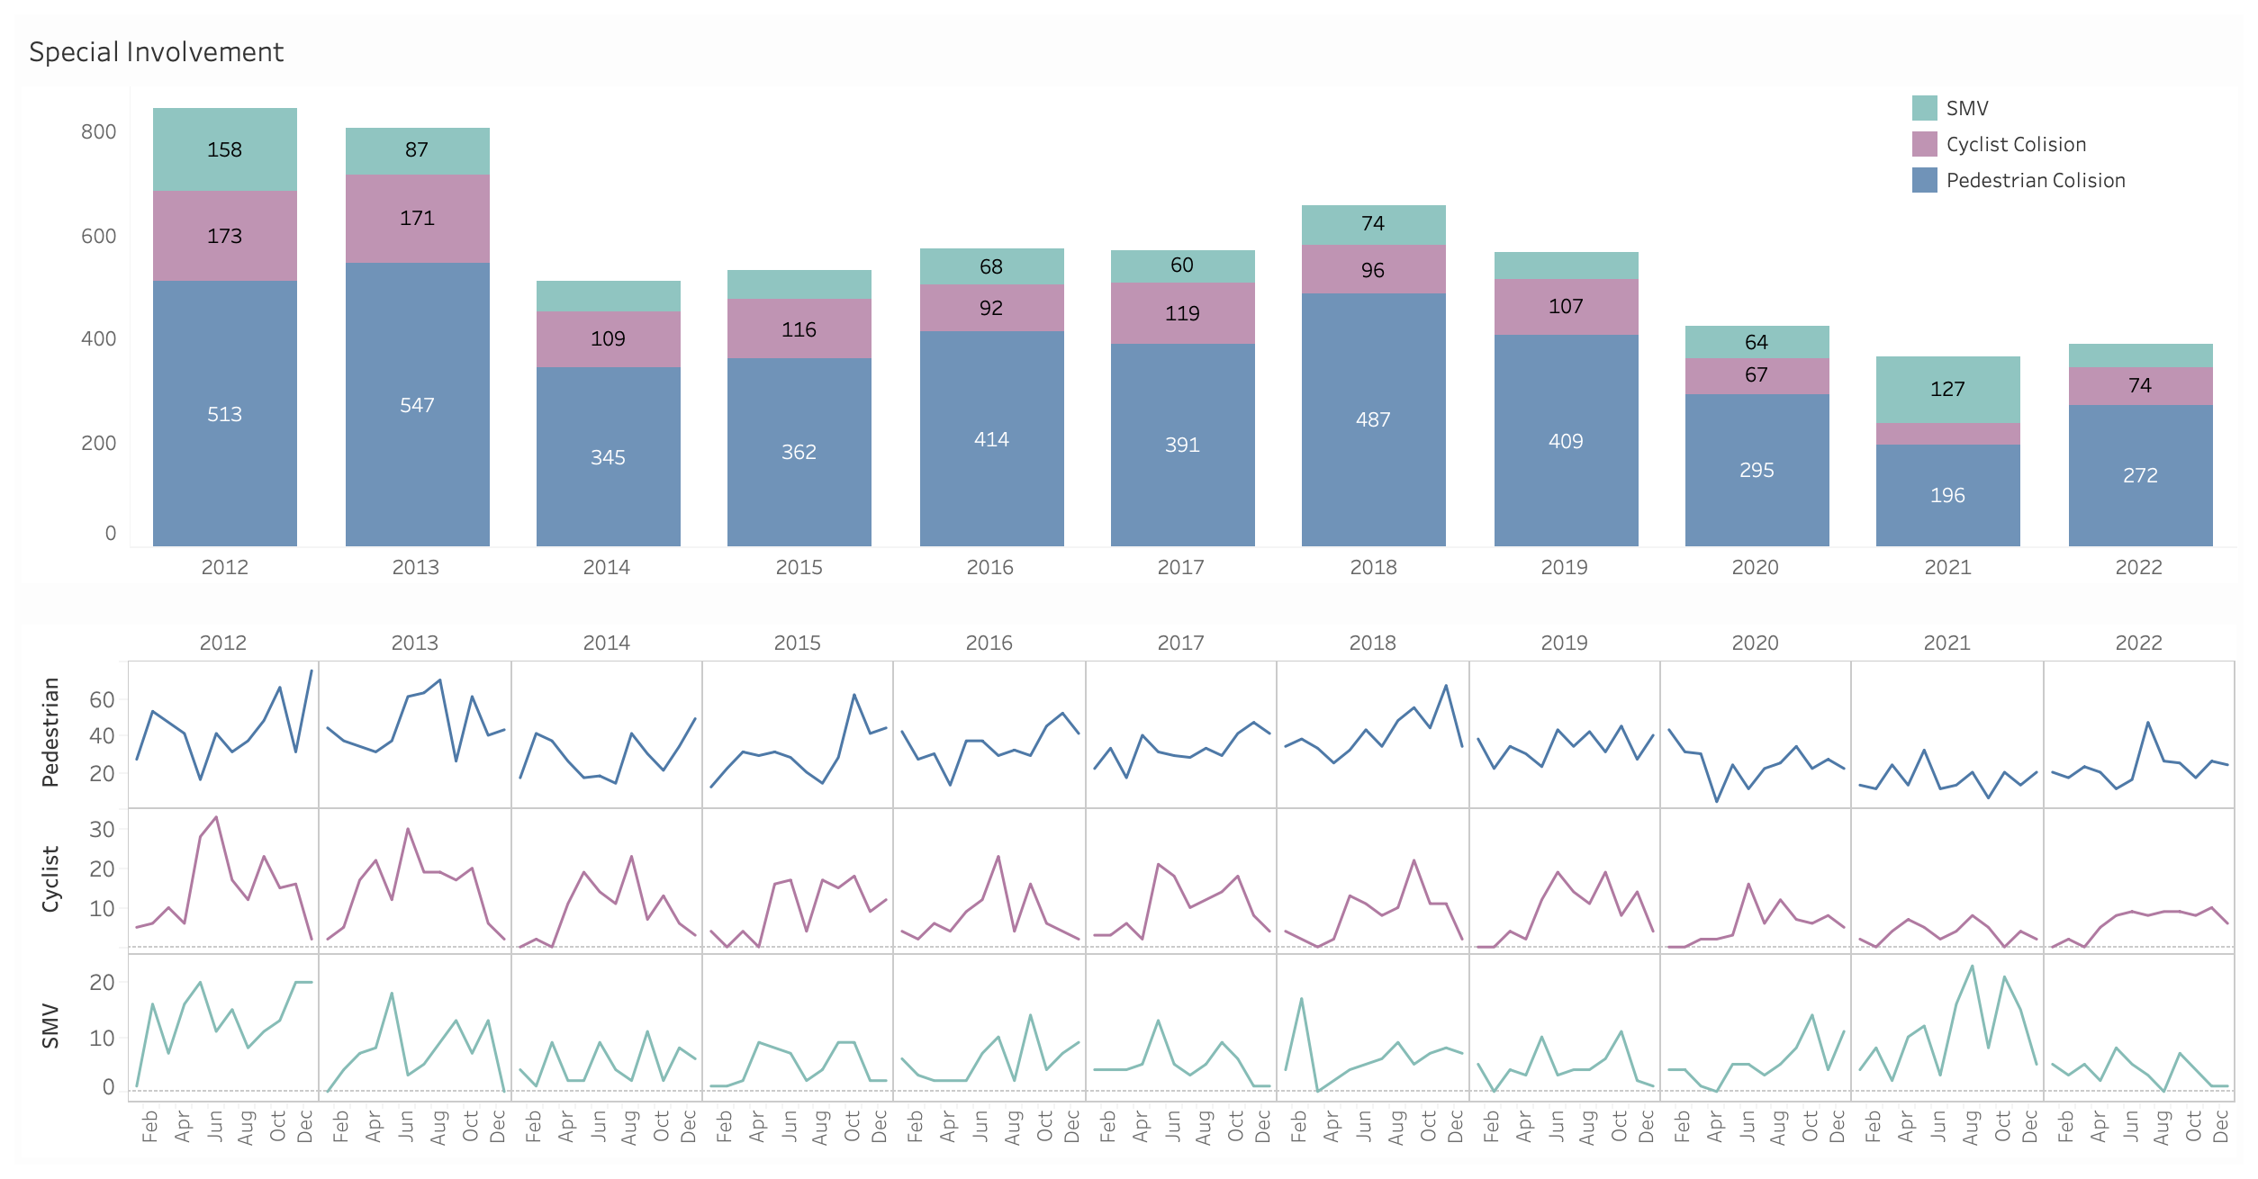
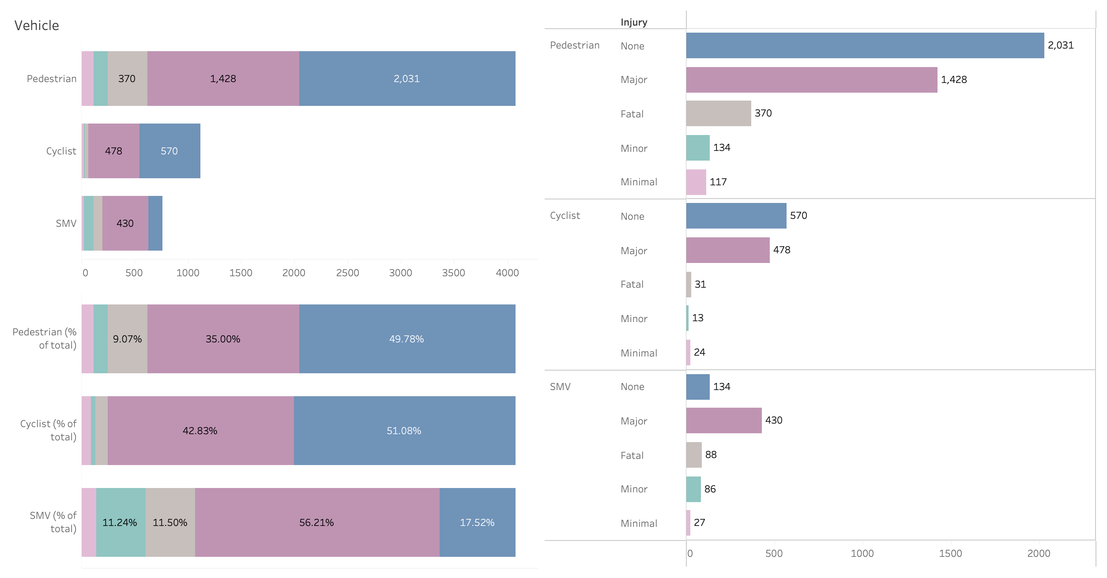
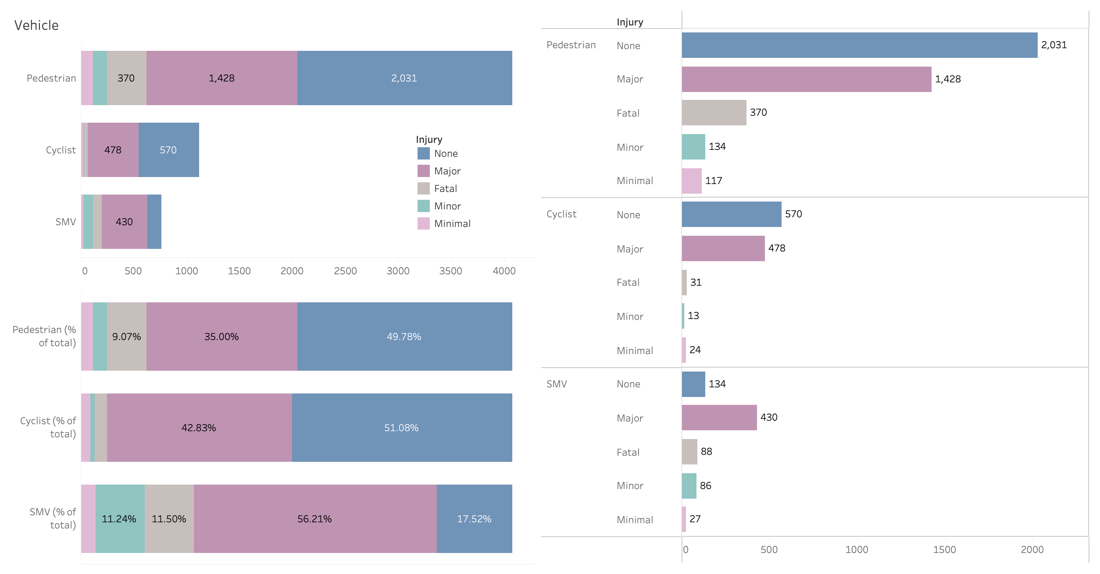
Visualization
Accidents happened to pedestrians more than to cyclists and slow-moving vehicles (SMVs).
For pedestrian and cyclist collisions, no injury and major injury are comparable in numbers.
For SMV collisions, major injury was the main consequence.

Slide 19
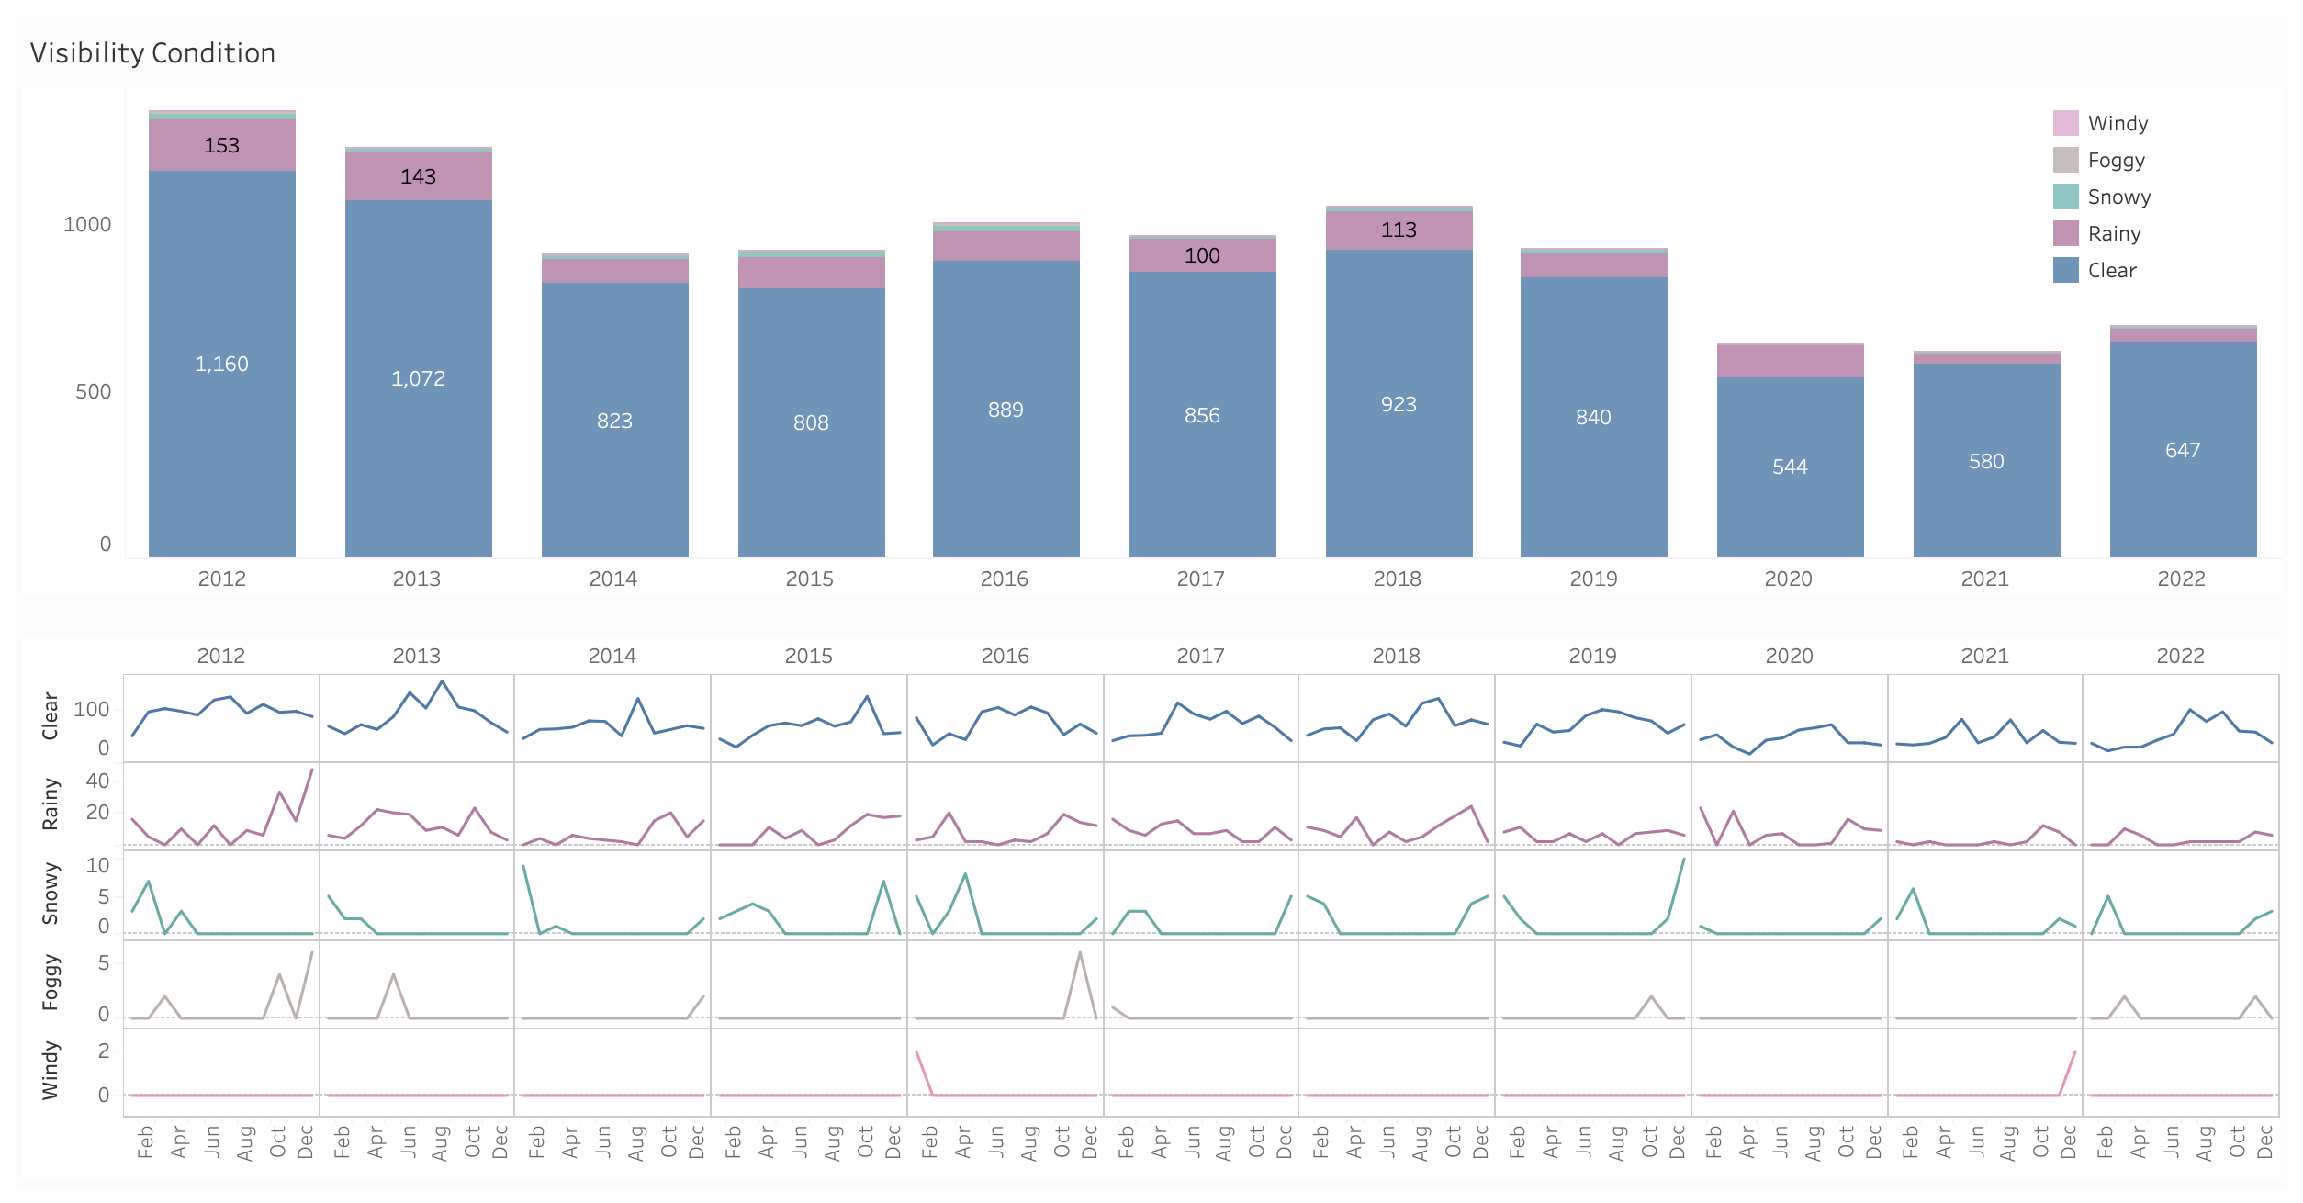
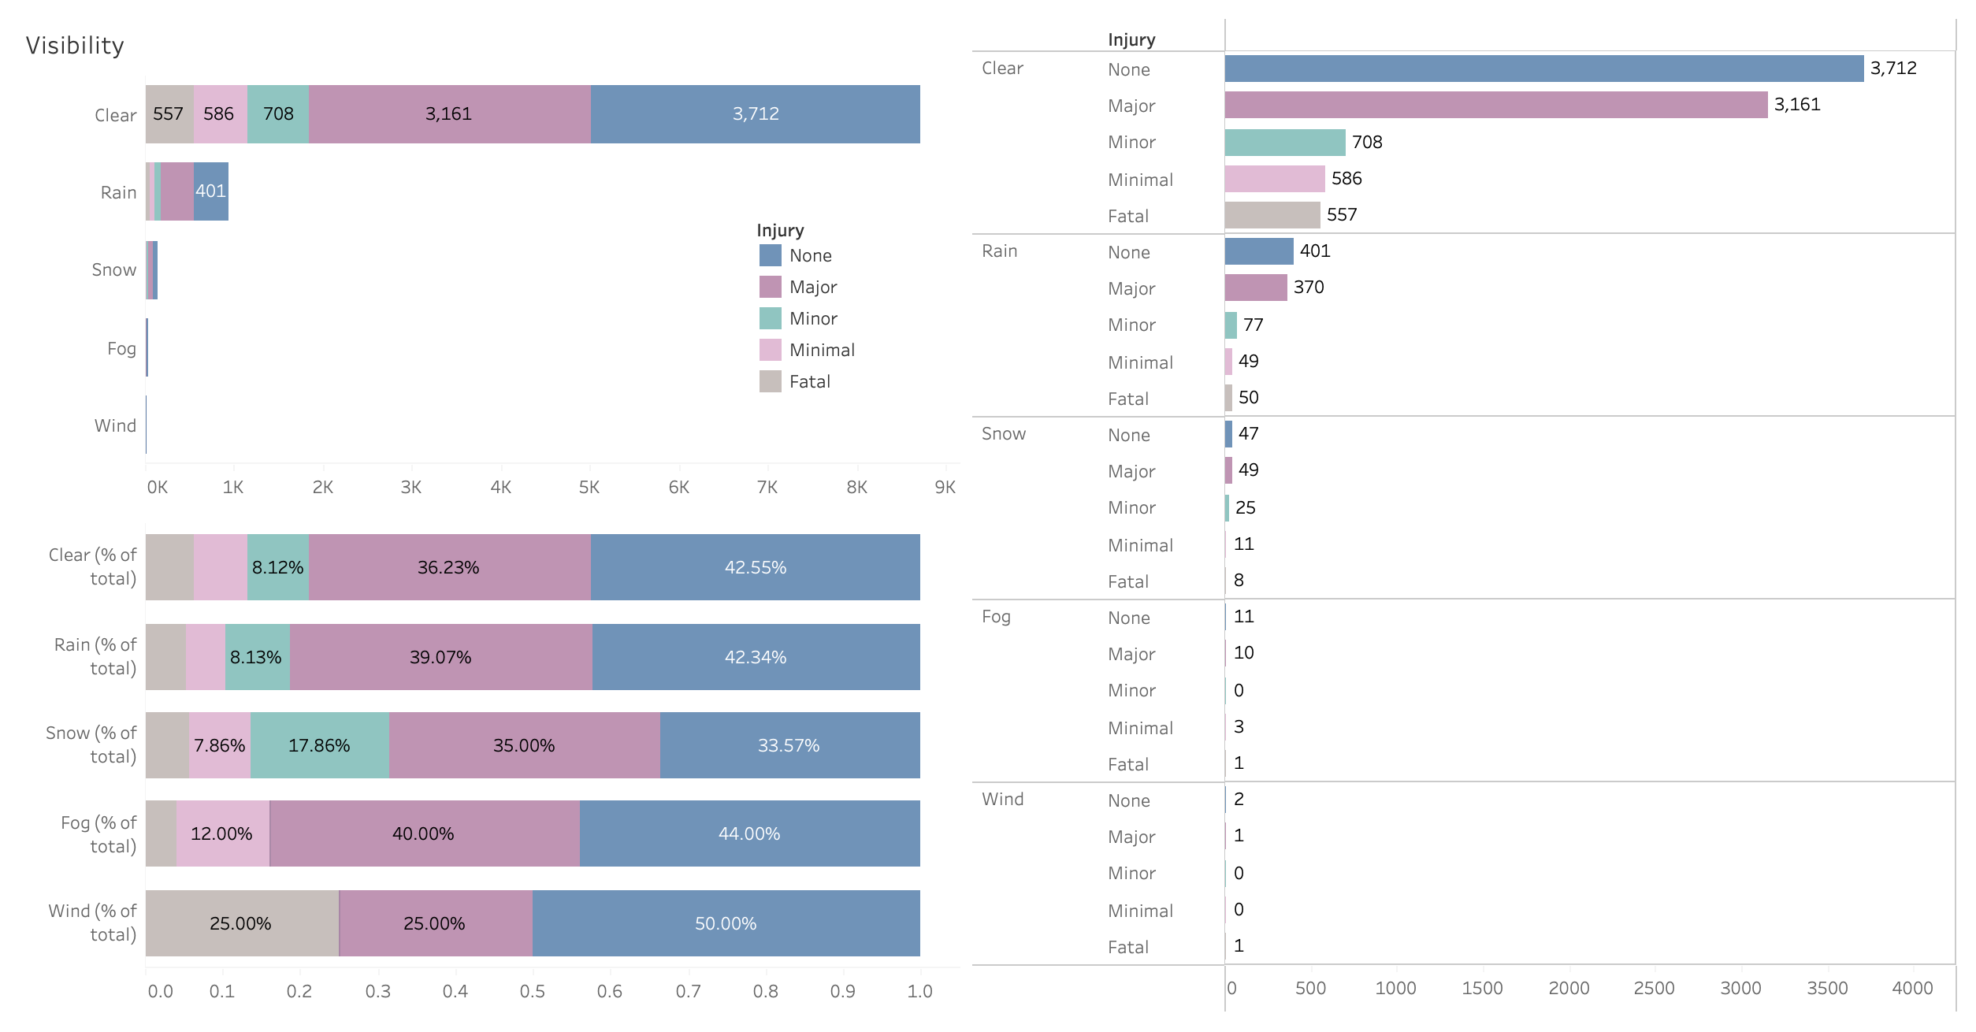
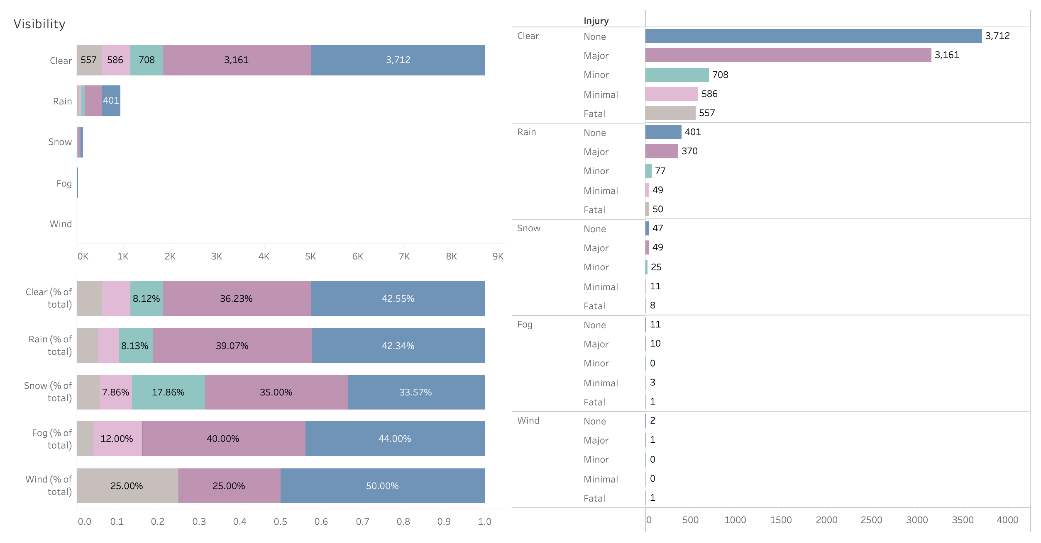
Visualization
Accidents happened mostly under clear vision.
Under snow vision, lower chance of no injury, higher chance of minor injury.

Slide 20

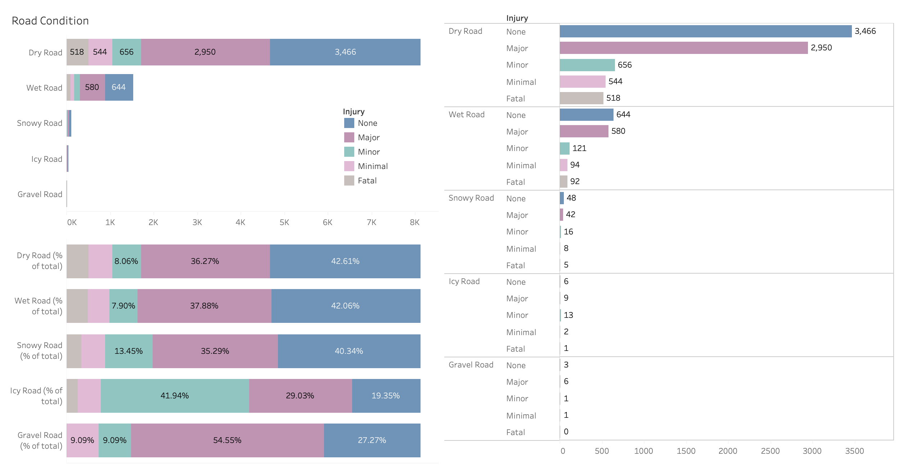
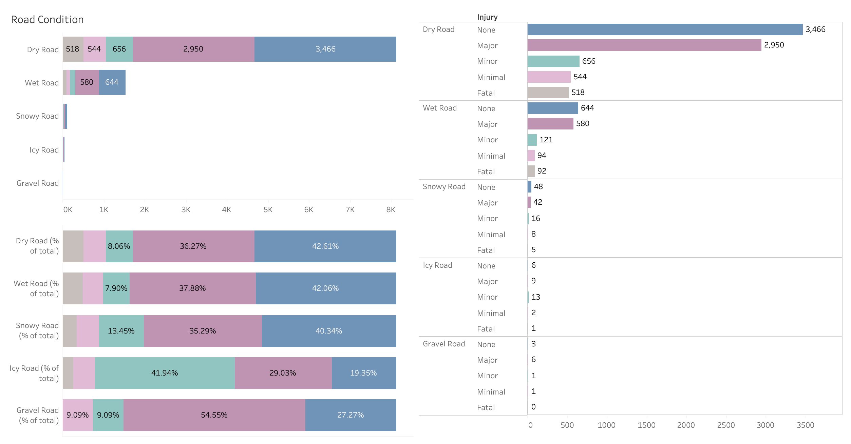
Visualization
Most accidents took place on dry roads.
On icy roads, higher chance to get minor injury.
On gravel roads, higher chance of major injury.

Slide 21
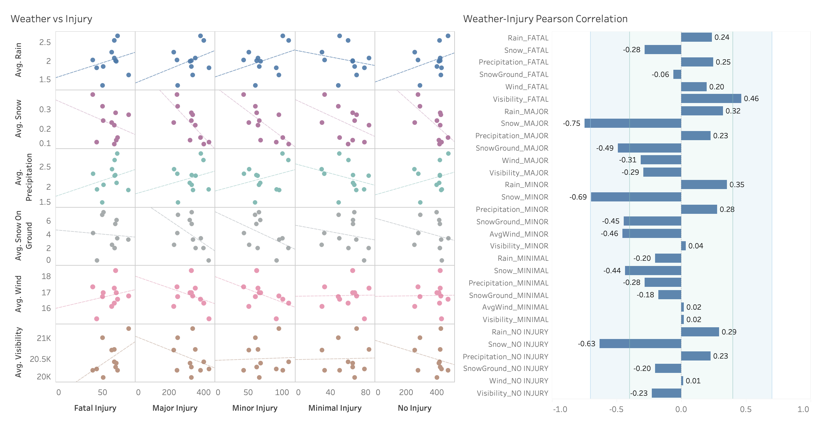
Visualization
Positive correlations: not substantial
Snowy weather correlated highly inversely with major, minor and no injury.
When the snow got heavier, there were fewer such injuries since commuters traveled less.

Slide 22
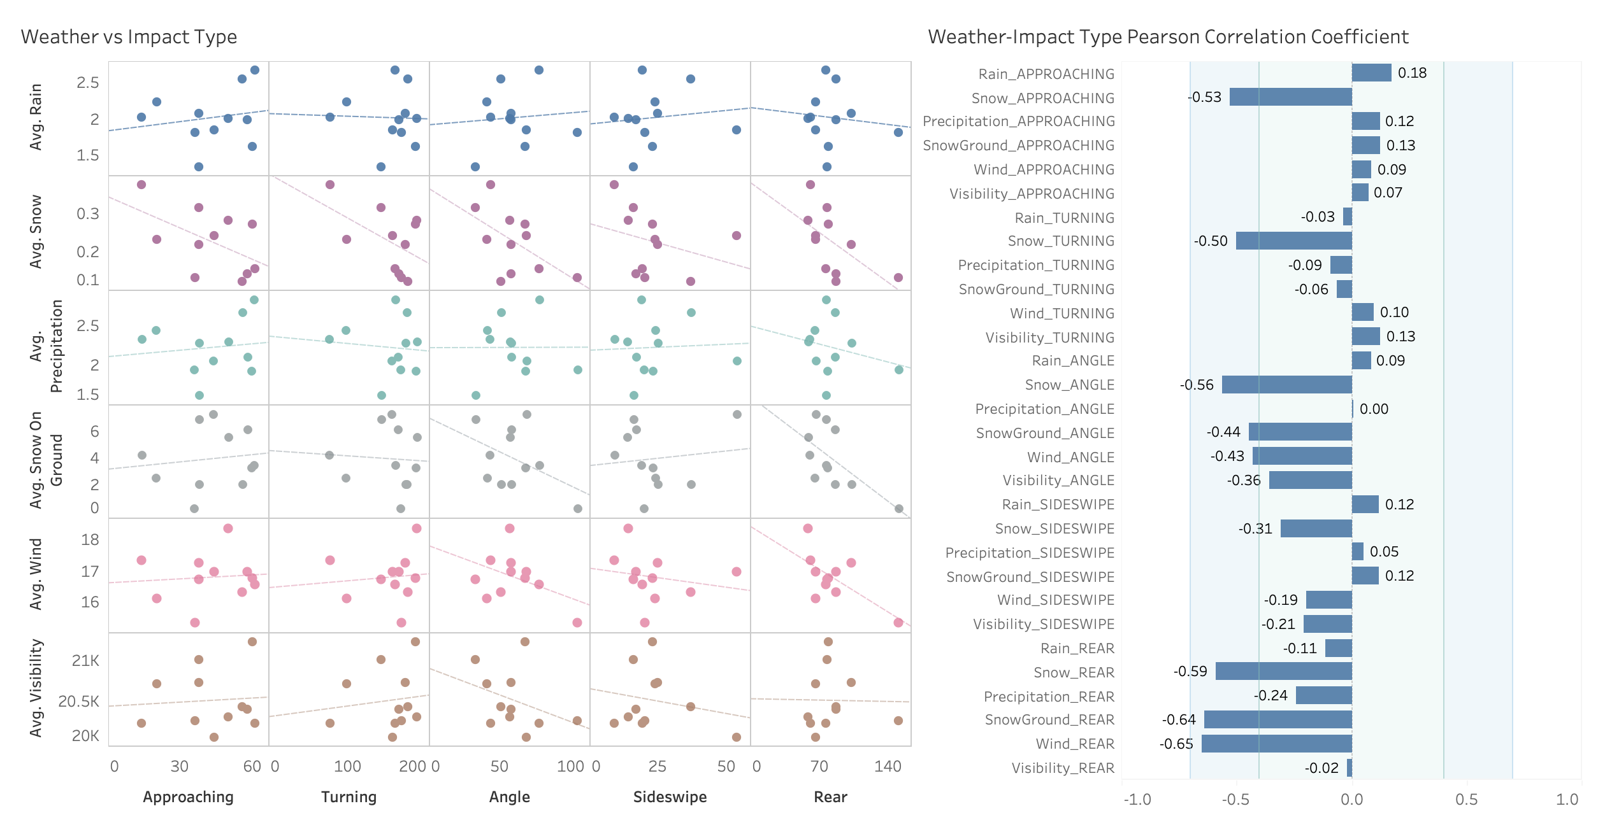
Visualization
Similar observations:
for positive correlations: not significant, for snow: prominent inverse correlations.
Besides snow, wind speed had significant inverse correlation with rear collisions.

Slide 23
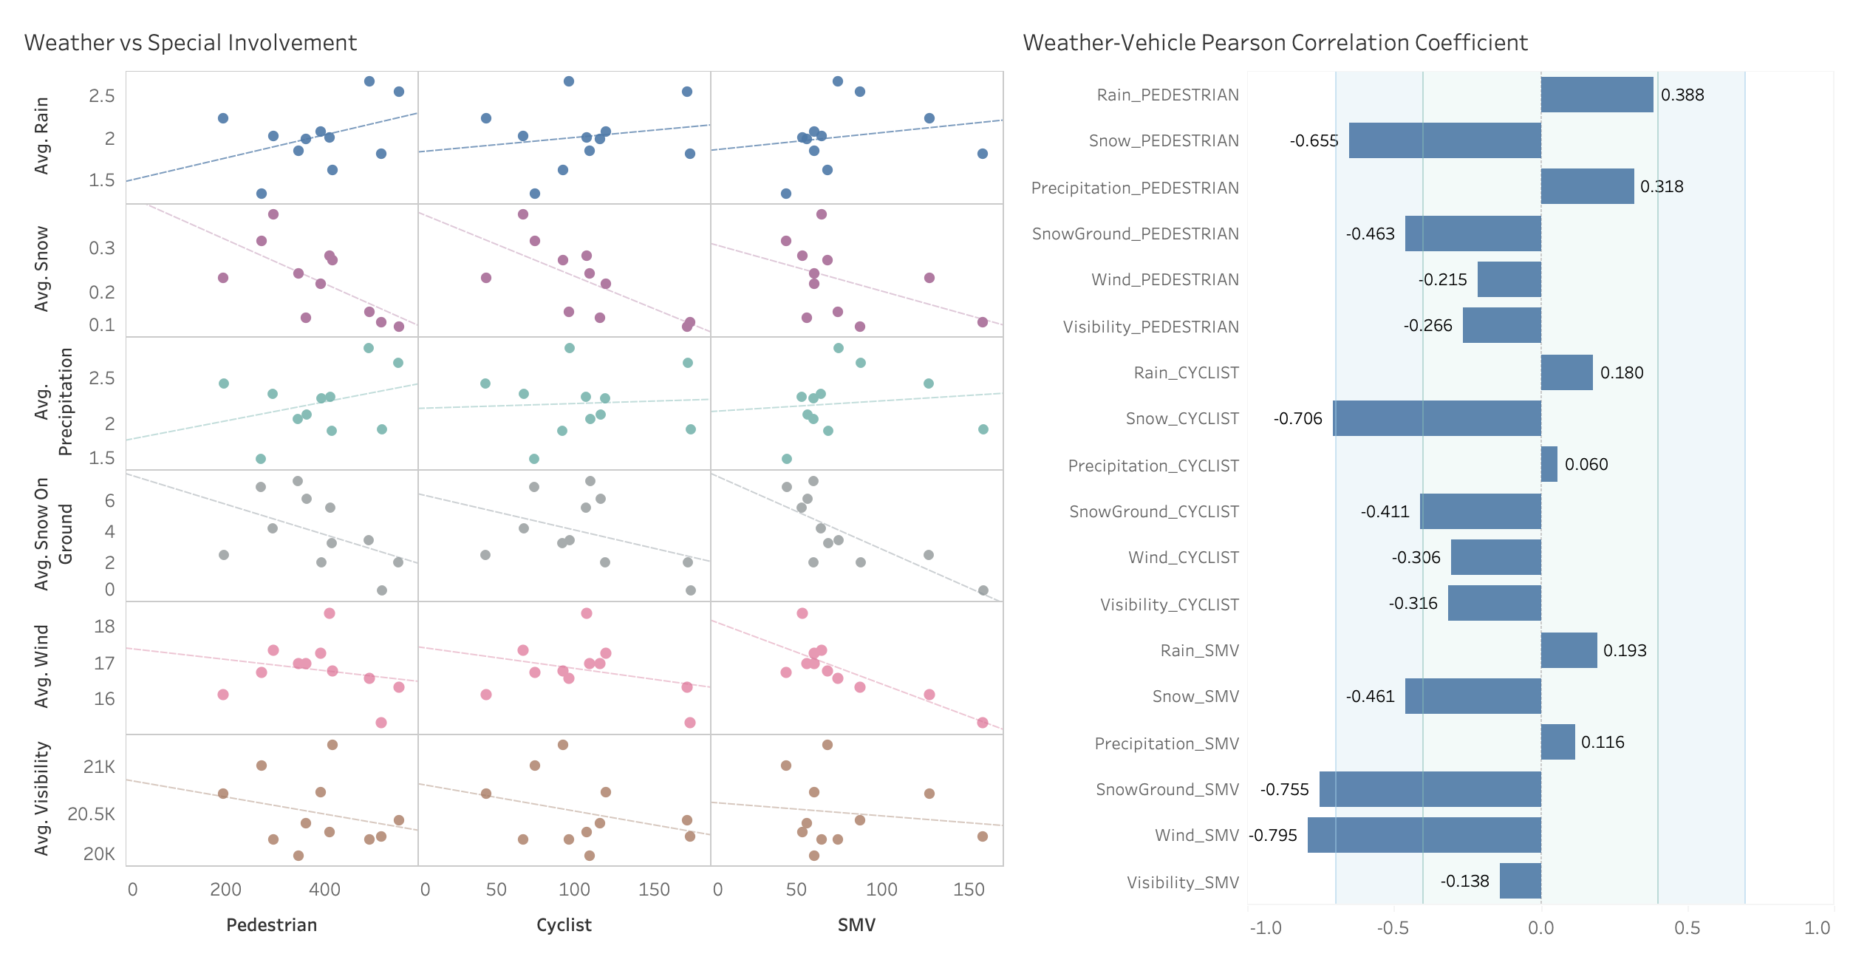
Visualization
Similar observations for positive correlations and snow.
Wind speed also had significant inverse correlation with collisions involving SMVs.

Slide 24
Summary
Number of traffic crashes was decreasing, then increasing in 2020-2022.
Accidents happened most frequently with:
Light condition: Day and night hours (vs. dusk and dawn)
Road condition & Visibility : Dry roads, clear vision
Impact type: Turning vehicles
Special involvement: Pedestrian (vs cyclist, SMVs)
Injury: No injury (40-45% chance) and major injury (36-38%).
Special observations:
Light condition: Number of collisions at night decreased more slowly than those in day.
Light condition: During dark and dawn, fatal injury had greater chance.
Road condition & Visibility: In snow and on icy roads, minor injury happened more. On gravel roads, major injury.
Impact type: In an approaching impact collision, major and minor injury were more likely to happen.
Special involvement: In collisions involving SMVs, major injury mainly occurred.
Once snow or wind had started:
The heavier the snow, the fewer collisions of almost all types.
The stronger the wind, the fewer rear collisions as well as fewer collisions involving SMVs.

Slide 25
Thank you!

